Slide 1
Leo-Futsal
Presented by
Manish Shrestha
Kshitij Gurung
Kushal Kapre

Slide 2
Introduction
A fast-paced indoor soccer game, is popular for its emphasis on skill and teamwork. To enhance the booking experience, we've developed a mobile app using Flutter, providing a smooth and responsive platform for reserving futsal courts.
Our backend, built with Laravel, effectively manages user reservations, court availability, and vendor interactions, offering real-time updates to help users make informed decisions.
The app is user-friendly, catering to the needs of futsal players and improving the overall experience.
The Leo-Futsal application features two main modules:
User Module: Allows easy court booking and payments via the Khalti gateway, ensuring a seamless process across devices.
Admin Module: Provides full management capabilities for administrators, overseeing venues, user accounts, and app features.
Developed in Visual Studio Code, the app integrates robustly with MySQL, ensuring efficient system performance and maintenance.

Slide 3
Problem Statement
Data Security:
Android apps handle sensitive customer info.
At risk of cyber-attacks.
Essential to keep customer data safe.
Inefficient Booking Systems:
Booking futsal courts is complicated.
Interfaces are hard to use.
Takes too long to make reservations.
User Dissatisfaction:
Hard to organize futsal games.
Users aren't happy with the booking process.
Makes enjoying futsal less fun.

Slide 4
Objectives
Dynamic Mobile App: Use Flutter to build a responsive app that prioritizes a seamless user experience for easy futsal court reservations.
Robust Backend System: Using Laravel, create a dependable backend architecture to effectively manage user reservations, court availability, and vendor interactions.
Real-Time Updates: Make sure users have accurate information to make well-informed booking selections by providing them with up-to-date information about court availability.
User-Centric Features: Align the app with the requirements and preferences of the user by introducing amenities selection, team development, and in-app communication.

Slide 5
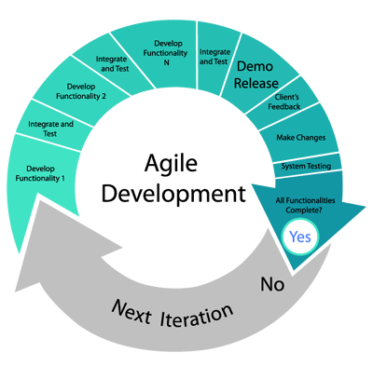
Metholodogy
The Agile methodology is being utilized to develop Leo Futsal, a futsal booking app.

Slide 6
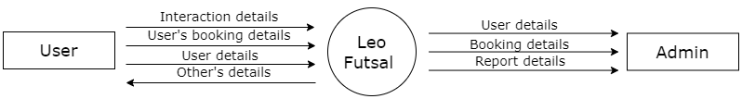
System design
Context level dfd

Slide 7
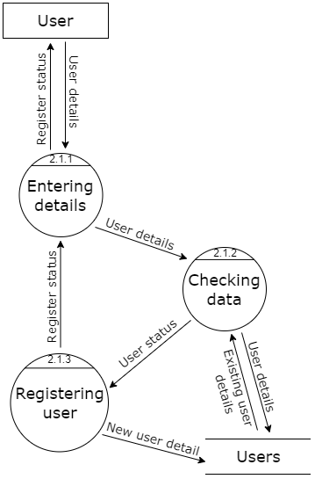
Level 2 dfd for user registration

Slide 8
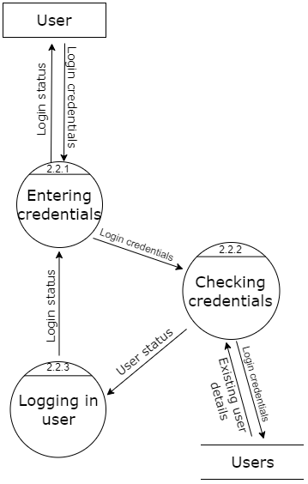
Level 2 dfd for user login

Slide 9
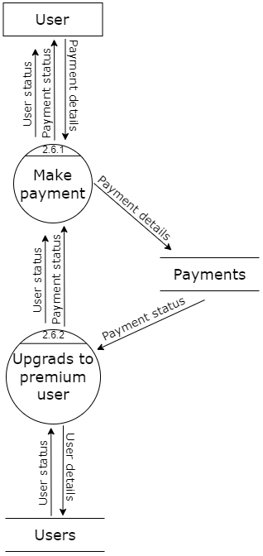
Level 2 dfd for Payment

Slide 10
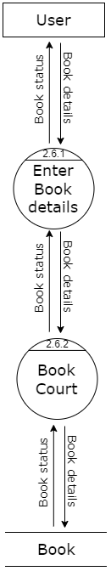
Level 2 dfd for court booking

Slide 11
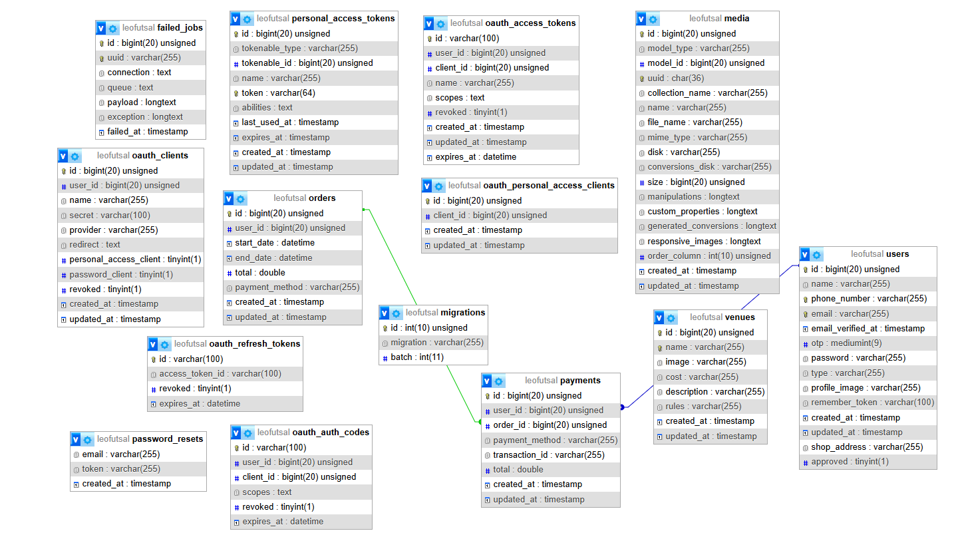
Database Schema
A database schema is a logical structure that represents the organization of data in a database. It defines the tables, fields, relationships, views, indexes, and other elements that constitute the database.

Slide 12
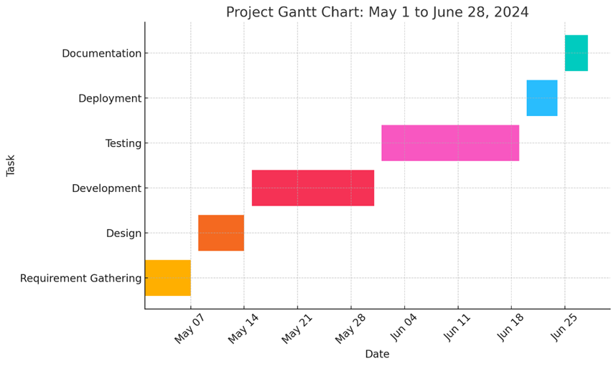
Gant chart

Slide 13
Project result
Improved User Experience: A well-designed app that simplifies the booking process and provides real-time updates will enhance user satisfaction and retention.
Operational Efficiency: A dependable backend system will streamline operations for court managers and vendors, reducing administrative burdens and improving service quality.
Enhanced Community Engagement: Features that support team development and communication will help build a vibrant futsal community, encouraging more players to participate and stay engaged.
Increased Adoption: The comprehensive and user-centric design of the app will attract a wide user base, promoting the adoption of digital solutions for futsal reservations and potentially expanding to other sports facilities in the future.

Slide 14
Future Enchament
Advanced Payment Options: Integrate digital wallets, cryptocurrencies,
and installment plans for diverse payment preferences.
Enhanced Social Features: Add player profiles, match history tracking,
and social media integration to enhance user interaction and engagement.
Analytics for Vendors: Offer detailed insights to court owners on user behavior
and preferences to optimize management and improve services.
Multi-Sport Facility Booking: Expand booking capabilities to include basketball courts,
tennis courts, and swimming pools to attract a broader user base and increase app utility.

Slide 15
Conclusion
Leo Futsal simplifies and enhances futsal court reservations with a user-friendly mobile app. Utilizing Flutter for frontend and Laravel for backend, it ensures a seamless booking experience.
Real-time updates and robust backend management optimize user convenience and minimize scheduling issues.
Features like amenities selection and in-app communication promote community engagement.
Future enhancements include AI recommendations, multi-sport bookings, and advanced social features to further enrich user experience and expand utility across sports.
Leo Futsal aims to innovate continuously, meeting sports enthusiasts' evolving needs with efficiency and enjoyment.

Slide 16
References
ChatGPT - OpenAI:https://openai.com/research/chatgpt/
FIFA (2007). Big Count 2006: Statistical Summary Report, FIFA Communications Division, 2007. [Online]. Available: http://www.fifa.com/mm/document/fifafacts/bcoffsurv/bigcount.su mmaryreport_7022.pdf. [Last accessed Jan. 27 2014].
Football Federation Australia (2009). National Football Development Plan. [Online]. Available http://www.klufc.org.au/publications/ffa-national-footballdevelopment-plan. [Last accessed Jan. 25 2014]; Cited by Australia Soccer International, Jul/Aug 2009, 17 Issue 7, p68.
Shafiee S, Rostami H, Mamashloo H, Deh Panah S. SWOT Analysis of Golestan Province's Football and Delivering Suitable Strategies. Sport Dev Manage. 2017;6(2):119-140.
Abrahamsson, P., Salo, O., Ronkainen, J., & Warsta, J. (2017, September 25). Agile software development methods: Review and analysis. arXiv (arXiv:1709.08439). Retrieved from

Slide 17
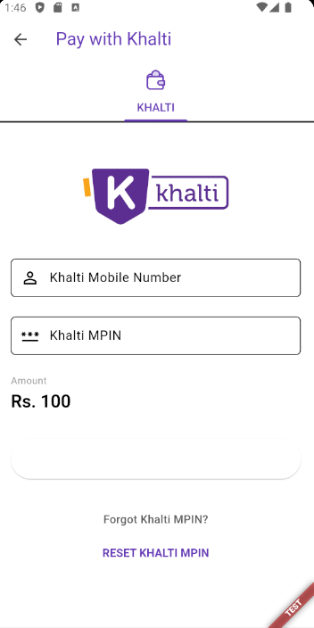
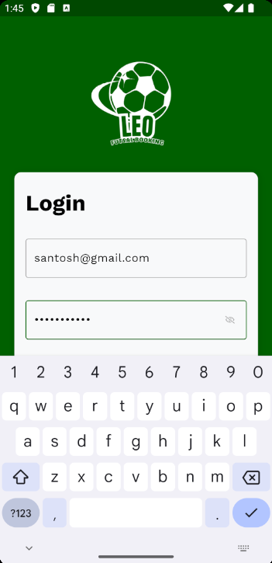
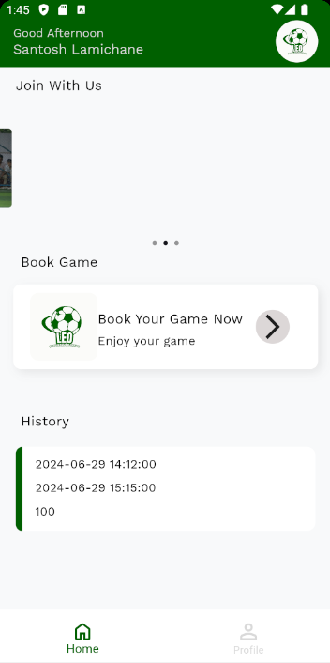
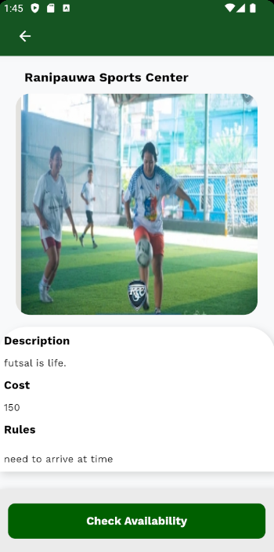
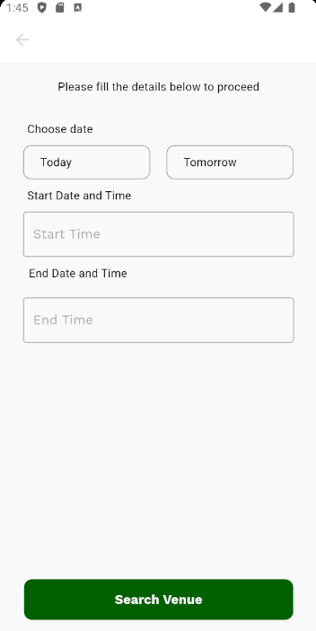
Annex

